Slide 1
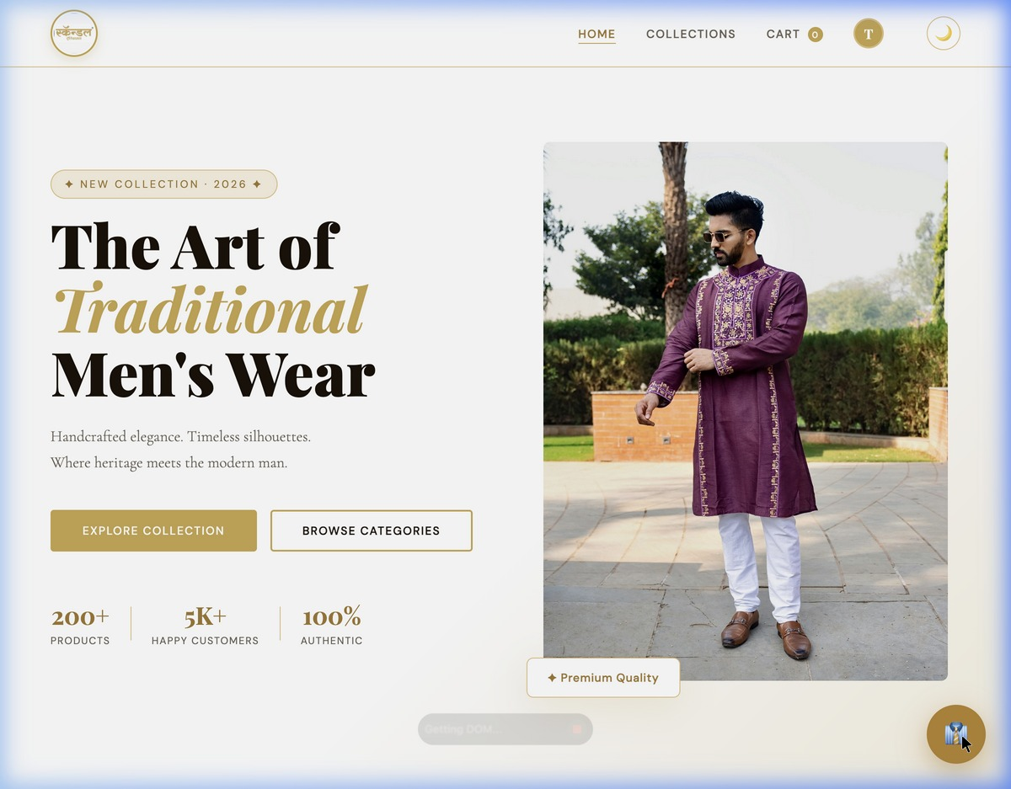
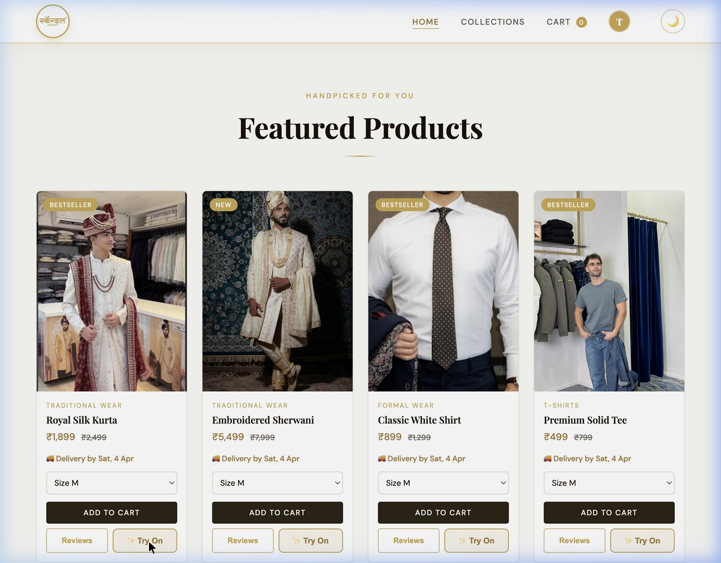
Scandal-Traditional Men’s Wear
E-Commerce Platform
Nishi Shah - 16010125808
Khush Satra - 16010125815
Harshit Panchal - 16010125810
KJ Somaiya School of Engineering

Slide 2
Problem Statement
Traditional Men's Wear — including Kurtas, Sherwanis, and Nehru Jackets — represents a ₹40,000+ Crore industry in India. Small boutiques like Scandal Men's Wear, Thane have loyal local customers but no digital presence, limiting their reach and growth potential. Without an online platform, customers must visit the store physically to browse and purchase, there is no size guidance leading to wrong purchases and returns, and the business has no visibility beyond its local area. Additionally, the absence of order tracking and flexible payment options further reduces customer convenience and trust.
To address these challenges, there is a clear need for a full-stack, responsive e-commerce web platform that digitizes the complete shopping experience — from product browsing to secure checkout, order tracking, and personalized recommendations. This project also aligns with SDG 8 – Decent Work & Economic Growth, as it empowers a small Indian traditional wear business to scale digitally, reach a wider audience, and grow sustainably through technology.

Slide 3
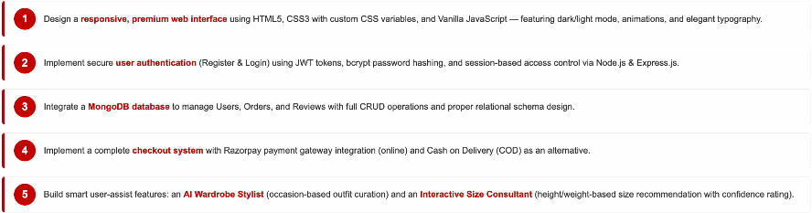
Project Objectives

Slide 4

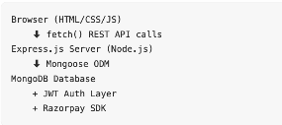


Tools & Technologies Used
System Architecture

Slide 5
UI Design – Homepage & Product Catalogue
Custom gold schema + Playfair Display typography
Dark/Light mode toggle with LocalStorage persistance
Animated product bagdes (Bestseller, New, Trending)
Delivery date shown dynamically on every card

Slide 6
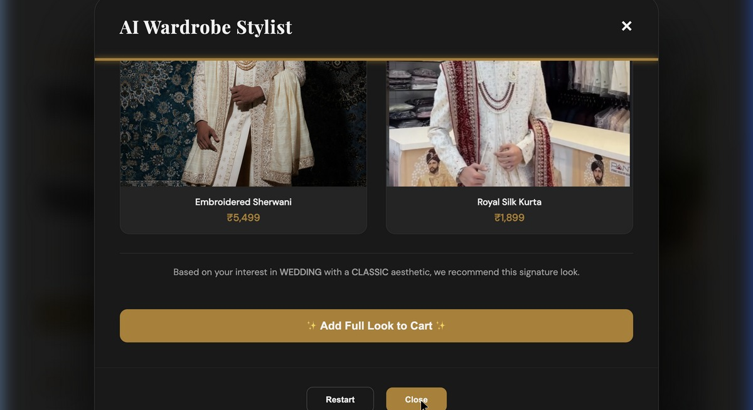
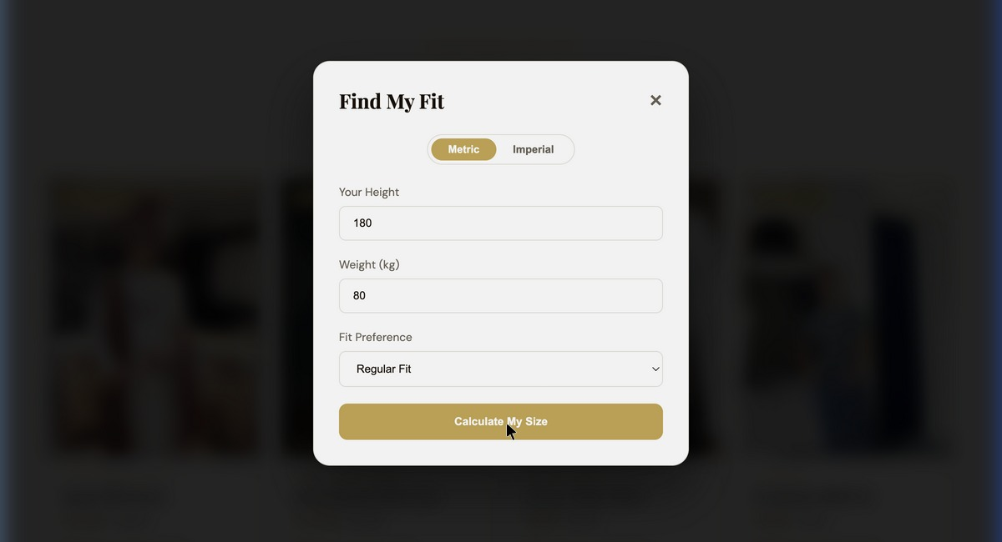
Smart User Features – AI Stylist & Size Consultant
AI Wardrobe stylist
Interactive Size Consultant
12 outfit recipes across 4 occasions
“Add full look to Cart” – One-click shopping
Metric & imperial units supported
Auto-fills size dropdown on product card

Slide 7
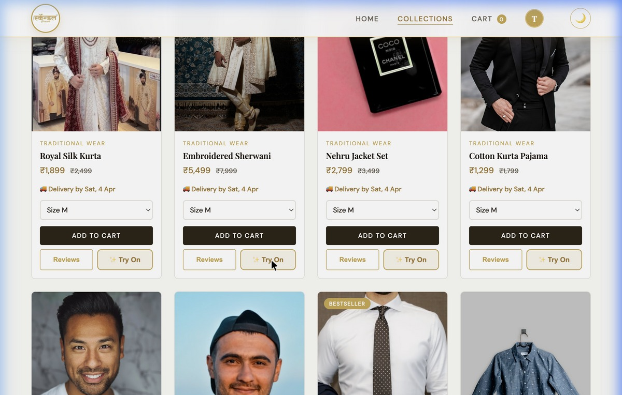
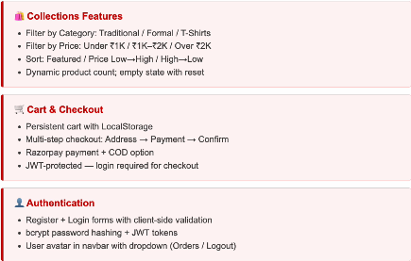
UI Design – Collections, Cart & Authentication

Slide 8
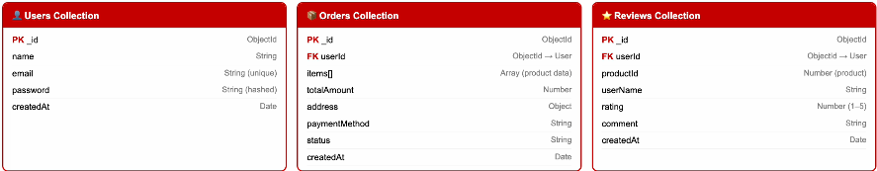
Database Schema – MongoDB Collection Design

Slide 9
Future Scope & Conclusion
Future Enhancements
Interactive Lookbook – Shop outfits directly from editorial photography with hover-to-add-cart
Admin Dashboard– Product management, inventory control, order analysis
Live Order Tracking – Real-time logistics integration with shipment APIs
Mobile App – React native extension for iOS and Android platforms
Premium Gifting – Gold-stamped gift notes, custom packaging for festive season
Github Repo : https://github.com/nishi-shah231/Scandal

Slide 10
Thank You
: )

